Slide 1
Tetris Progress Report and Design
-Alex Schexnayder

Slide 2
Presentation Outline
Finished Implementing
UML Design
Use Case Sequence Diagram
Things left to implement
Future Test Cases
Updated Timeline
Questions?

Slide 3
Finished implementing
Every piece’s shape in reference to the grid
All rotation options of every piece
Random piece generator
Updates after every previous random piece
UI Design (might change color scheme in the future)
2-dimensional grid
Logic for checking grid rows and emptying those rows if necessary

Slide 4
UML Design

Slide 5
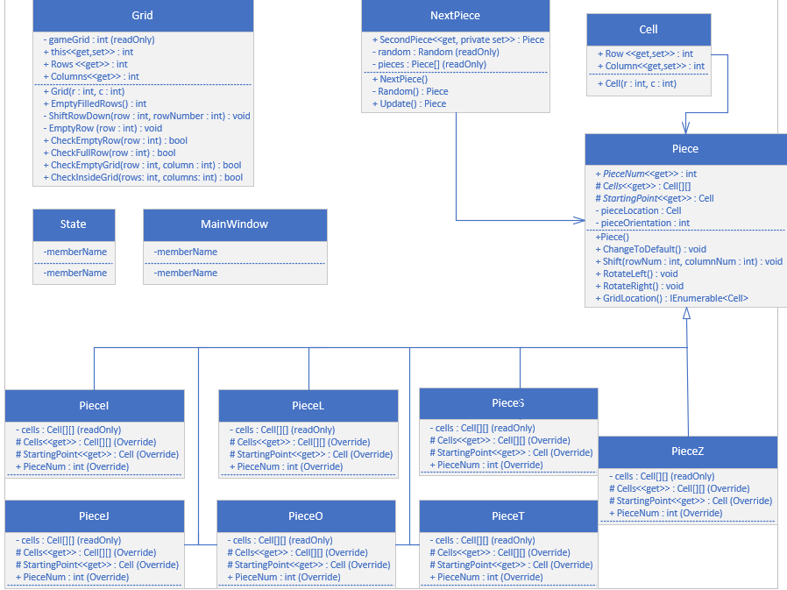

Slide 6
Use Case Sequence Diagram

Slide 7
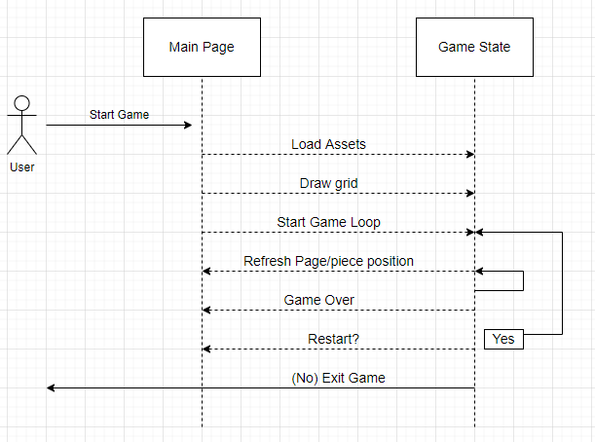

Slide 8
Things left to implement
Game state class
Main control that dictates the rules and actions of the game
Calls on already established classes for functionality
Changes state based on game progress. (In progress, finished, reset, etc.)
Importing assets
UI
Event handlers for piece movement/rotation and game loop functions
Draw the game grid and pieces
Timer for pieces to move down
Making Test Cases

Slide 9
Future Test Cases
Test 1 (Game loop is correct):
Once top row of game grid fills, the game ends
Goes back to starting screen to exit or restart game
Test 2 (Score is correct):
Score increments correctly with each filled row
Score resets on game restart
Test 3 (Pieces go to correct spot):
Pieces stack on top of one each other
Unable for 2 pieces to go to the same array cell if filled

Slide 10
Updated Timeline
April 10
Finished functionality for accurate game loop
April 13
All bug fixes are finished
Test cases completed
April 25
Possible stretch goal(s) implementation
May
Fully finished project with correct functionality and game loop
Final Presentation
Submit project

Slide 11
Questions?

